Slide 1


Slide 2

How to boost your Frontend development using Fake APIs

Slide 3

Agenda
Why is this useful
New features
Existing functionalities
Saved time
Technologies used
Documentation
Example applications

Slide 4

1
How to boost your frontend development using fake apis
Why is this useful
Notes:
Chapter Intro Slide (version P)
This slide should be used at the beginning of each “chapter” of your presentation (as introduced in the Agenda slide) to keep the audience aware of their place in the story and to help break things up. Change the text and chapter number accordingly. If you do not need a sub-head (the smaller text), delete it. Use different backgrounds for different chapter titles, try not to repeat a background.
Very short presentations (< ~10 slides) may not need Chapter Intro Slides.
There are multiple versions of this template with various white and black background images starting on slide 10.

Slide 5


How to boost your frontend development using fake APIs - 1. Why is this useful
Developing components in parallel with backend
Api contracts
The only alternative is to wait for backend to finish. Extra integration is needed after the implementation is finished. However the time needed to do implementation this way is still significantly less then the time that would be needed for, to wait for backend part to be finished.
Need to be determined prior. Changing API contract in time is sometimes necessary and expected. Extra time is needed to change API responses on fake API and then alter implementation but sometimes it is not avoidable.
Notes:
Elements (version 1)
Elements are used to give more detail to a set of ideas, they should all relate to the same topic.
For example, use this page for a list of deliverables, key roles on a project, phases of a project, or any topic that can be broken down into more specific examples.
Each section should have an icon that relates to the content of that specific element, no icon should be repeated on the same page, and they should all be the same colour.
Keep the text to 1-2 sentences and aim to have about the same amount of content under each element.

Slide 6

Some use cases can be quickly tested only by changing cached data via fake API.
Response can be delayed from fake API to simulate real life scenario.
Responses can be used for later.
examples
Notes:
Concept slide (version 2)
Concept slides create “breathing room” in presentations by having white space and focusing on a few key details.
They are intended to represent important information, quotes, or Endava marketing messages to the audience.

Slide 7
2
How to boost your frontend development using fake apis
New features
Notes:
Chapter Intro Slide (version P)
This slide should be used at the beginning of each “chapter” of your presentation (as introduced in the Agenda slide) to keep the audience aware of their place in the story and to help break things up. Change the text and chapter number accordingly. If you do not need a sub-head (the smaller text), delete it. Use different backgrounds for different chapter titles, try not to repeat a background.
Very short presentations (< ~10 slides) may not need Chapter Intro Slides.
There are multiple versions of this template with various white and black background images starting on slide 10.

Slide 8
How to boost your frontend development using fake APIs - 2. New features
Starting from scratch
Changing API contracts
To implement new features, fake responses should be made from API contract examples. It is useful to have single source of truth (official documentation, wiki page, code is the best documentation ☺ ).
Sometimes some details are not predicted at starting point which is causing a change in API contract.
Notes:
Elements (version 1)
Elements are used to give more detail to a set of ideas, they should all relate to the same topic.
For example, use this page for a list of deliverables, key roles on a project, phases of a project, or any topic that can be broken down into more specific examples.
Each section should have an icon that relates to the content of that specific element, no icon should be repeated on the same page, and they should all be the same colour.
Keep the text to 1-2 sentences and aim to have about the same amount of content under each element.

Slide 9
3
How to boost your frontend development using fake apis
Existing functionalities
Notes:
Chapter Intro Slide (version P)
This slide should be used at the beginning of each “chapter” of your presentation (as introduced in the Agenda slide) to keep the audience aware of their place in the story and to help break things up. Change the text and chapter number accordingly. If you do not need a sub-head (the smaller text), delete it. Use different backgrounds for different chapter titles, try not to repeat a background.
Very short presentations (< ~10 slides) may not need Chapter Intro Slides.
There are multiple versions of this template with various white and black background images starting on slide 10.

Slide 10
How to boost your frontend development using fake APIs - 3. Existing functionalities
Specific value or field is added
Caching
The caching can be implemented in a way that fake API app is first trying to find information in local cache, and if it doesn’t exist it should try to retrieve info from real API. If API endpoint doesn’t exist, the empty response can be created in cache.
The real response can be used as an example and by changing some value or adding a new field, fake API can be used for development.
Notes:
Elements (version 1)
Elements are used to give more detail to a set of ideas, they should all relate to the same topic.
For example, use this page for a list of deliverables, key roles on a project, phases of a project, or any topic that can be broken down into more specific examples.
Each section should have an icon that relates to the content of that specific element, no icon should be repeated on the same page, and they should all be the same colour.
Keep the text to 1-2 sentences and aim to have about the same amount of content under each element.

Slide 11
4
How to boost your frontend development using fake apis
Saved time
Notes:
Chapter Intro Slide (version P)
This slide should be used at the beginning of each “chapter” of your presentation (as introduced in the Agenda slide) to keep the audience aware of their place in the story and to help break things up. Change the text and chapter number accordingly. If you do not need a sub-head (the smaller text), delete it. Use different backgrounds for different chapter titles, try not to repeat a background.
Very short presentations (< ~10 slides) may not need Chapter Intro Slides.
There are multiple versions of this template with various white and black background images starting on slide 10.

Slide 12



How to boost your frontend development using fake APIs - 4. Saved time
Example
For backend work, 10 man-hour is needed. For frontend work, the same. If frontend waits for backend to to finished, 20 man-hour would be needed. If the work is done in parallel, around 11 man-hour would be needed (an hour is needed for integration)
10
Man-hour
Frontend, backend
20
Man-hour
Frontend and backend work serial work
11
Man-hour
Frontend and backend in parallel (fake API)
Notes:
Key Figures
This slide highlights data and key figures.
Make sure to use an icon that relates to the data shown and all the icons are in the same colour.

Slide 13
How to boost your development using fake APIs - 4. Saved time
Result
1. Test
End to end tests should cover integration between backend and frontend, or some small amount of time is needed for adjustment.
2. Contract
If any API contract changes are needed, they are usually discovered early in development.
9 hours would be saved
Notes:
Standard text slide (version 6)
Creating contrast throughout the presentation can help to call attention to key ideas.
They can also create visual “breaks” in the cadence of the presentation and allow the eye to rest on big ideas.
The quotes should be important information, quotes, or Endava marketing messages.

Slide 14
5
How to boost your frontend development using fake apis
Technologies used for live example
Notes:
Chapter Intro Slide (version P)
This slide should be used at the beginning of each “chapter” of your presentation (as introduced in the Agenda slide) to keep the audience aware of their place in the story and to help break things up. Change the text and chapter number accordingly. If you do not need a sub-head (the smaller text), delete it. Use different backgrounds for different chapter titles, try not to repeat a background.
Very short presentations (< ~10 slides) may not need Chapter Intro Slides.
There are multiple versions of this template with various white and black background images starting on slide 10.

Slide 15
How to boost your frontend development using fake APIs - 5. Technologies used for live example
Technologies used
For live example
Flow
Frontend
Backend
React, Redux, React Router
AXIOS, Material UI
Node JS, Express
Nodemon, xml-builder
Notes:
Flow chart
Use to show how information breaks down, flows, connects, and relates to each other.

Slide 16
How to boost your frontend development using fake APIs - 5. Technologies used for live example
app
Sends requests to both fake api and api, and receives responses
Fake api
Receives requests from app and sends requests to api, then sends responses to app
api
Receives requests from fake api and api and sends responses
Desired
Flow
Live example
Notes:
Data slide (version 2)
Using data can be a powerful way to get an idea across to an audience.
Do not overwhelm the audience with too much information on the same slide.
Use these slides to highlight important facts and figures, with minimal text descriptions.

Slide 17
6
How to boost your frontend development using fake apis
Documentation
Notes:
Chapter Intro Slide (version P)
This slide should be used at the beginning of each “chapter” of your presentation (as introduced in the Agenda slide) to keep the audience aware of their place in the story and to help break things up. Change the text and chapter number accordingly. If you do not need a sub-head (the smaller text), delete it. Use different backgrounds for different chapter titles, try not to repeat a background.
Very short presentations (< ~10 slides) may not need Chapter Intro Slides.
There are multiple versions of this template with various white and black background images starting on slide 10.

Slide 18
How to boost your frontend development using fake APIs - 6. Documentation
Useful links
Frontend
React: https://reactjs.org/docs/getting-started.html
Redux: https://redux.js.org/
React router: https://reacttraining.com/react-router/web/guides/quick-start
Axios: https://github.com/axios/axios
Material UI: https://material-ui.com
Fake api
Node JS: https://nodejs.org/en/
Express: https://expressjs.com/
Nodemon: https://nodemon.io
Xml builder: https://www.npmjs.com/package/xmlbuilder
Notes:
Standard text slide (version 5)
Creating visual differences in text-heavy pages keeps the audience interested and engaged.
Using bold and highlighted coloured text draws the reader into the important part of the text. Use this sparing throughout the text, if it is used too much, the page becomes busy, it loses its’ meaning.
Varying the length of the paragraphs as well as using bulleted and numeric lists help with keeping the reader engaged. Lists help to “skim” the information on the page and allow the audience to absorb a just the key information.

Slide 19
7
How to boost your frontend development using fake apis
Example applications
Notes:
Chapter Intro Slide (version P)
This slide should be used at the beginning of each “chapter” of your presentation (as introduced in the Agenda slide) to keep the audience aware of their place in the story and to help break things up. Change the text and chapter number accordingly. If you do not need a sub-head (the smaller text), delete it. Use different backgrounds for different chapter titles, try not to repeat a background.
Very short presentations (< ~10 slides) may not need Chapter Intro Slides.
There are multiple versions of this template with various white and black background images starting on slide 10.

Slide 20
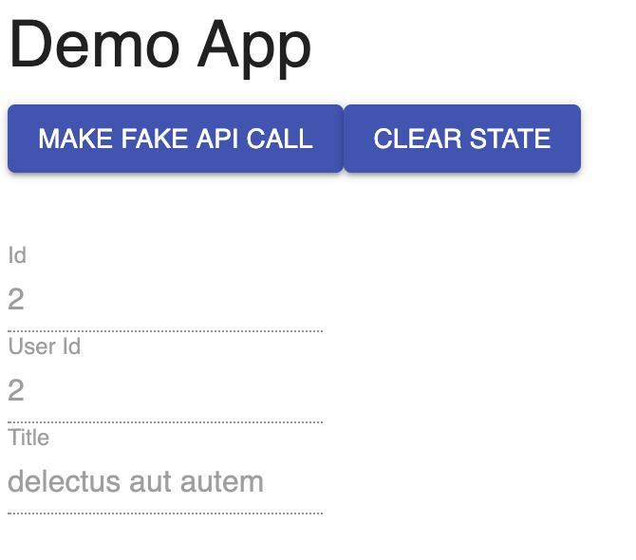
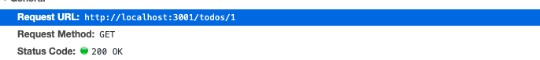
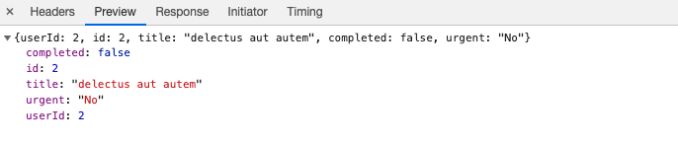
Front End App
We are confident in our abilities, our approach and our people so we have nothing to hide from our customers.
Basic navigation, Form, API calls, validation
Fake API App
API endpoint handlers
Example:
Notes:
Standard text slide (version 7)
Creating contrast throughout the presentation can help to call attention to key ideas.
They can also create visual “breaks” in the cadence of the presentation and allow the eye to rest on big ideas.
The quotes should be important information, quotes, or Endava marketing messages.

Slide 21
How to boost your frontend development using fake APIs - 7. Example applications
Use cases
Tasks | Api | Response type | Existing functionality
ADD new field ‘urgent’ | /todo/{todoId} | json | yes
Change response type to xml | /todo/{todoId} | xml | yes
Always from cache | /todo/{todoId} | json | yes
Add new form shopping list | /shoppingList/ {shoppingListId} | json | no
Notes:
Data slide (version 4)
Tables are mostly used to show the cost of the project.
To edit the rows and columns, click the table, then navigate to the top right of Keynote making sure “Format” is selected. Then select “Table” and you will be able to add or remove columns/rows, or many other customizations that fit the needs of the table. Do not change the look and feel of the table, just make adjustment to accommodate the specific client related data.

Slide 22
To summarize
Frontend development can be really improved by using fake APIs.
In most cases can boost and save time.
Dejan Joksimovic
Frontend developer
dejan.joksimovic@endava.com
Notes:
Standard text slide (version 1)
Use standard text slides as little as possible. They can be used for an introduction to a presentation, summary of work, detailed legal information.
All presentations should be a mix of text-heavy pages and visual pages.
In a presentation, choose between 1, 2, or 3 column text pages to be consistent within the document.

